Slide 1

Predicting Population Growth Dynamics in Response to Economic and Environmental Factors
FCSF Team 8 Mini-Project
Group Members:Hong xun, Ekhnoor, Marvyn

Slide 2
Our Aim and Motivation
Our goal is to develop a predictive framework
Forecast Population Growth
Assess Resilience and Preparedness
Policy Impact Analysis

Slide 3
Datasets We used
Demographic.csv
GDP by Country 1999-2022.csv
Combined_Data.csv
Education.csv
1900_2021disaster.csv
Healthcare.csv

Slide 4
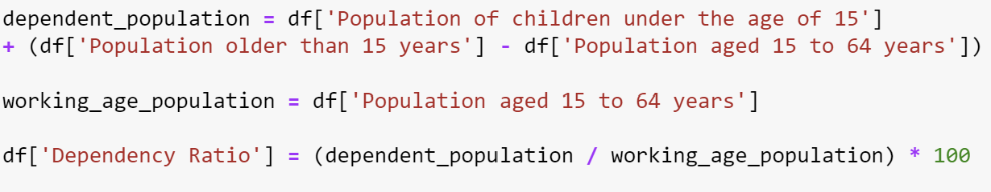
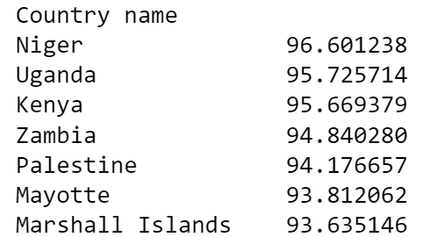
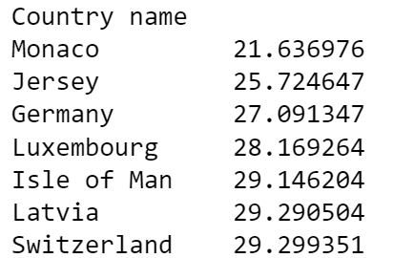
EDA EXPLANATION (Initial EDA)
EDA_Demographic_initial.ipnyb
Initial
GDP
Government
Natural Disasters
Most Dependent Countries
Least Dependent Countries

Slide 5
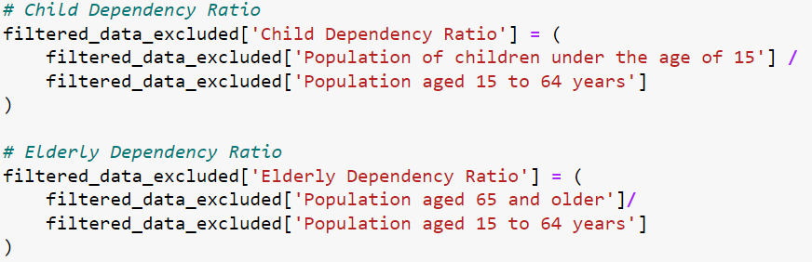
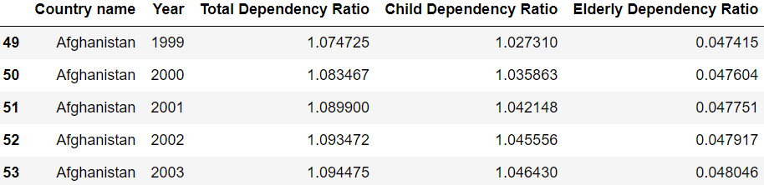
EDA_Demographic_initial.ipnyb
Initial
GDP
Government
Natural Disasters
EDA EXPLANATION (Initial EDA) (*this representation was calculated in GDP EDA but also in Initial.)

Slide 6
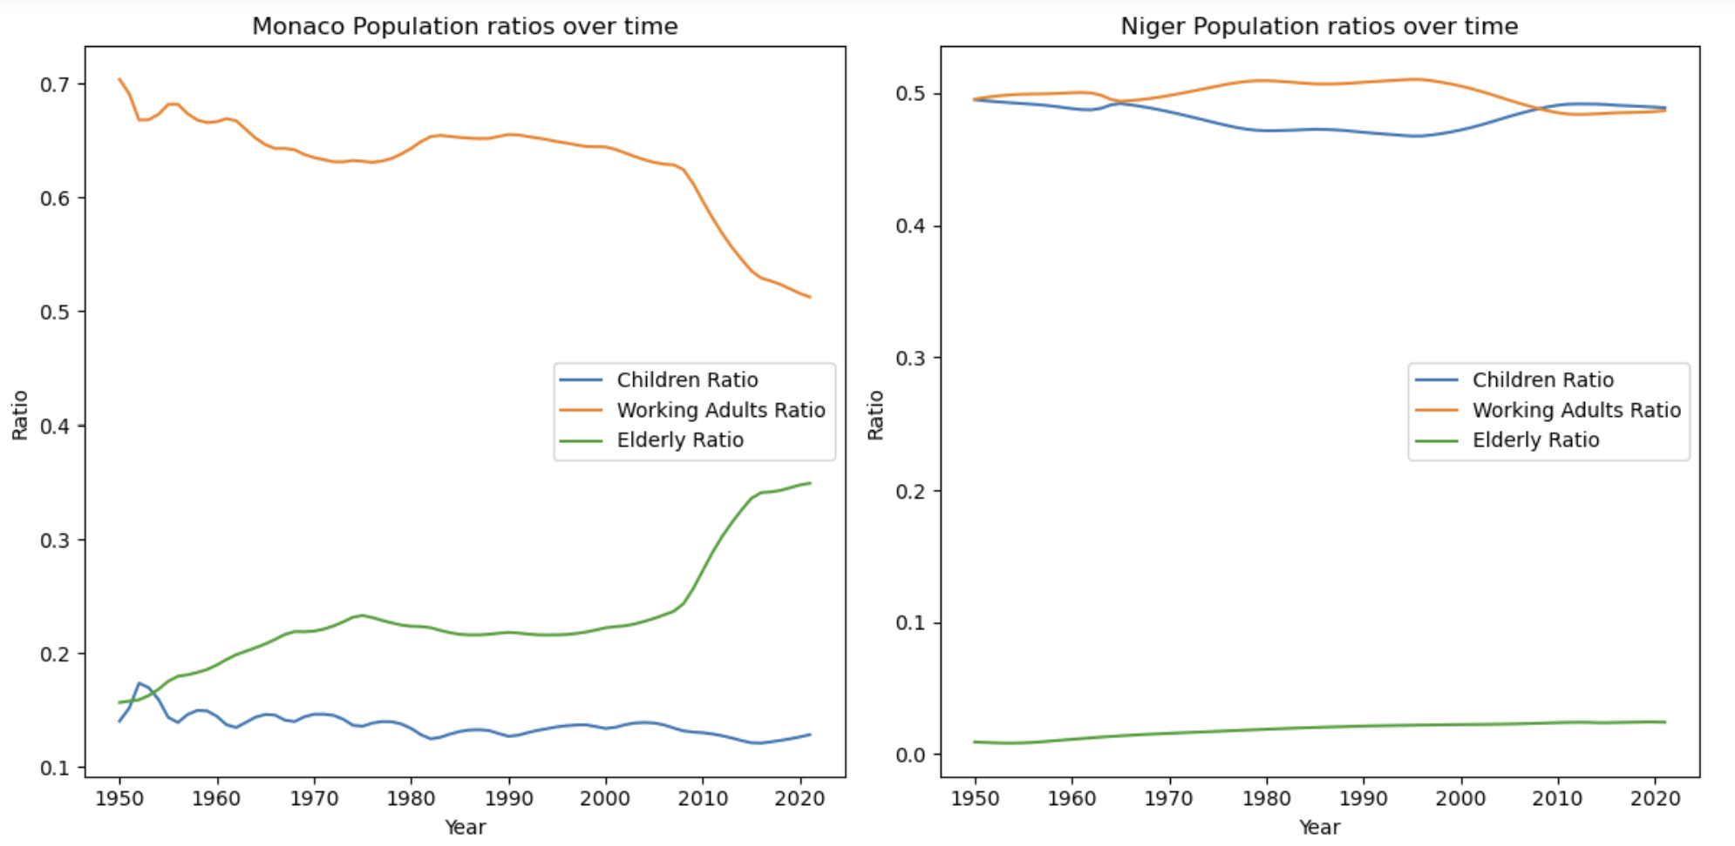
EDA EXPLANATION (Initial EDA)
EDA_Demographic_initial.ipnyb
Initial
GDP
Government
Natural Disasters
Monaco is progressing towards an ageing population, as evident from the low children ratio,
steep increase in elderly ratio and the falling working adult ratio.
- Potential indicator to explore, not just the dependency ratio

Slide 7
WHAT FACTORS WE CHOSE TO PREDICT THE DEPENDENCY RATIOS:
GDP
HEALTHCARE
EDUCATION
NATURAL DISASTERS

Slide 8
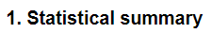
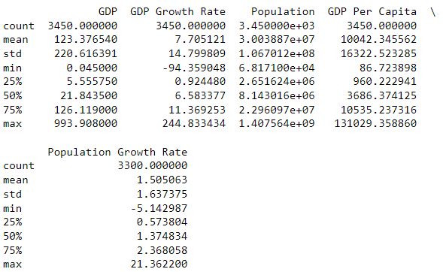
EDA EXPLANATION (GDP)
EDA_Demographic_GDP.ipnyb
Initial
GDP
Government
Natural Disasters

Slide 9
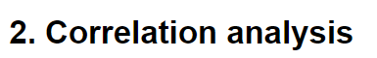
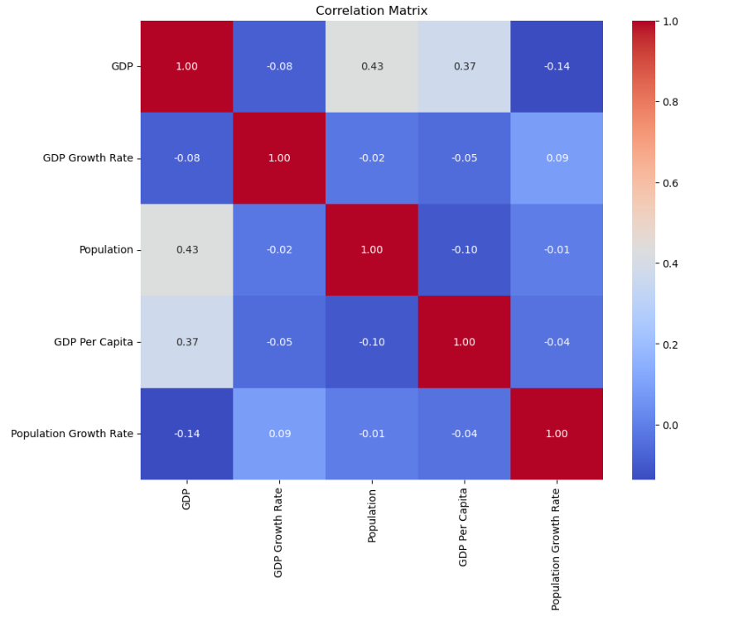
EDA_Demographic_GDP.ipnyb
Initial
GDP
Government
Natural Disasters
EDA EXPLANATION (GDP)

Slide 10
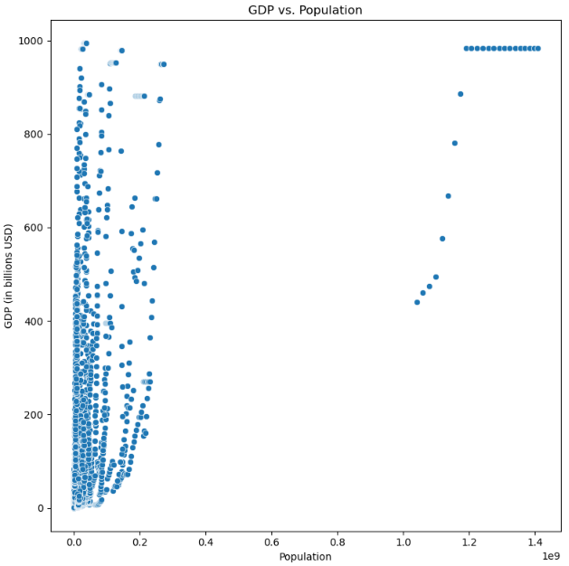
EDA_Demographic_GDP.ipnyb
Initial
GDP
Government
Natural Disasters
EDA EXPLANATION (GDP)
We can see that GDP has intermediate positive correlation with Population. We will proceed to split the population into separate age groups, more specifically dependency ratios which was mentioned in our first run of EDA. this allows us to analyse the relation between GDP and the demographics of a population.

Slide 11
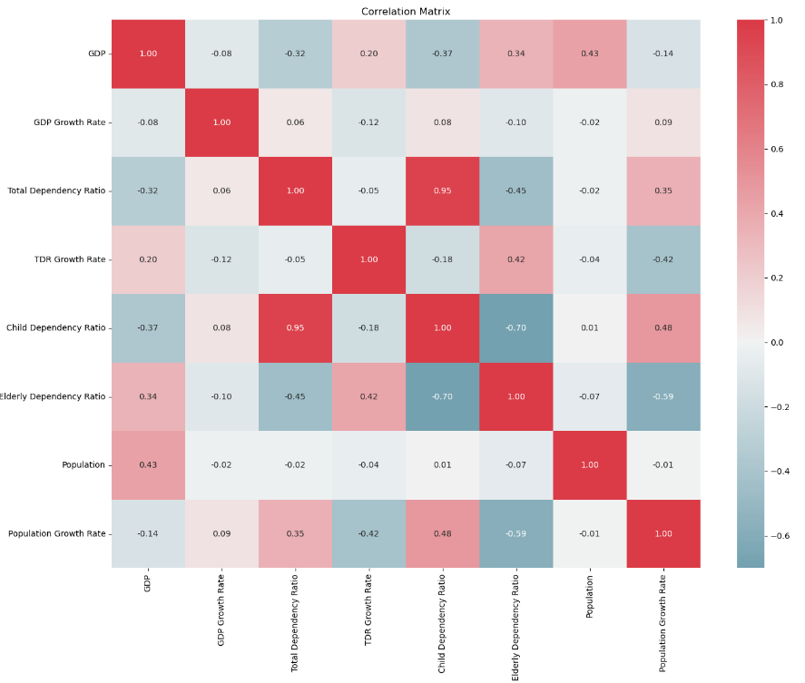
EDA_Demographic_GDP.ipnyb
Initial
GDP
Government
Natural Disasters
EDA EXPLANATION (GDP)
GDP

Slide 12
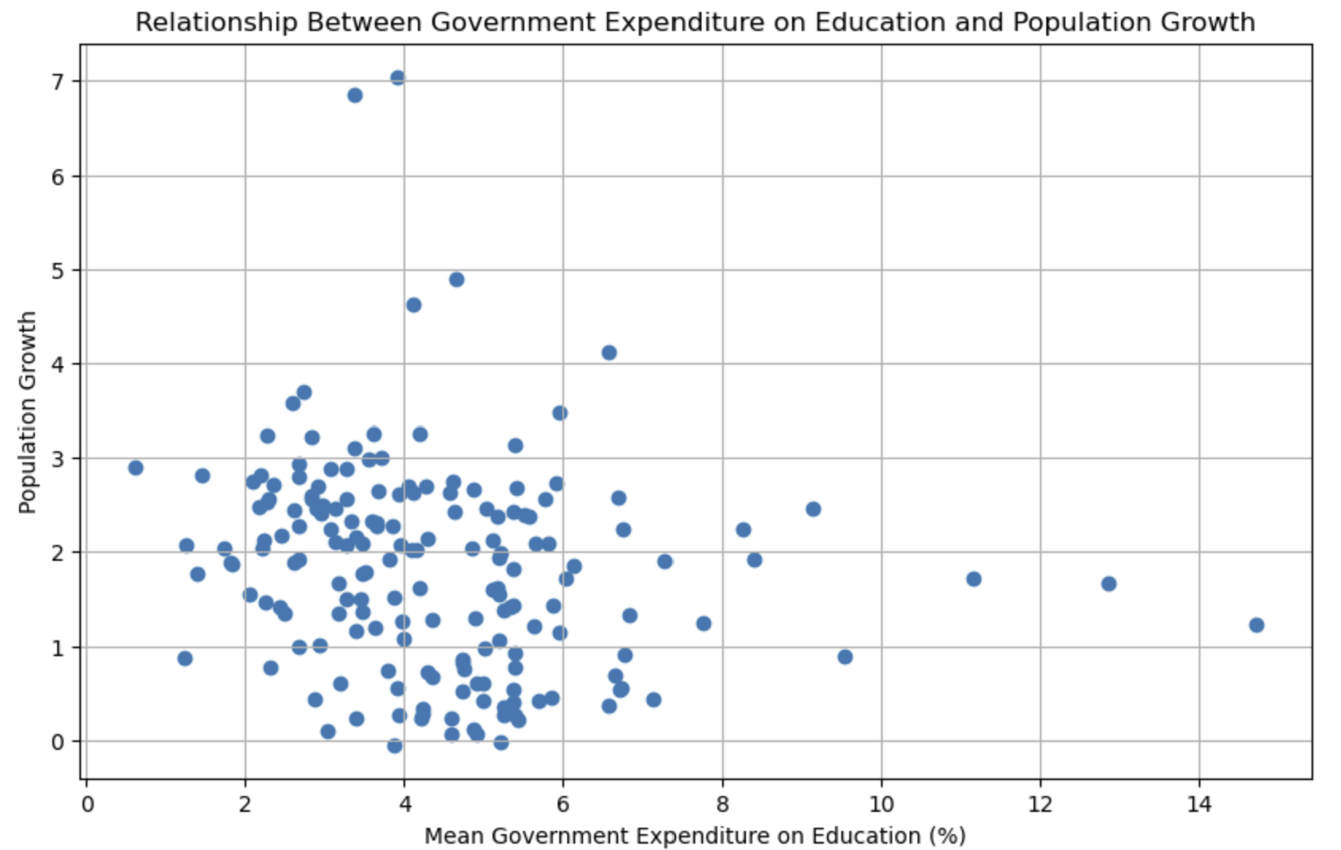
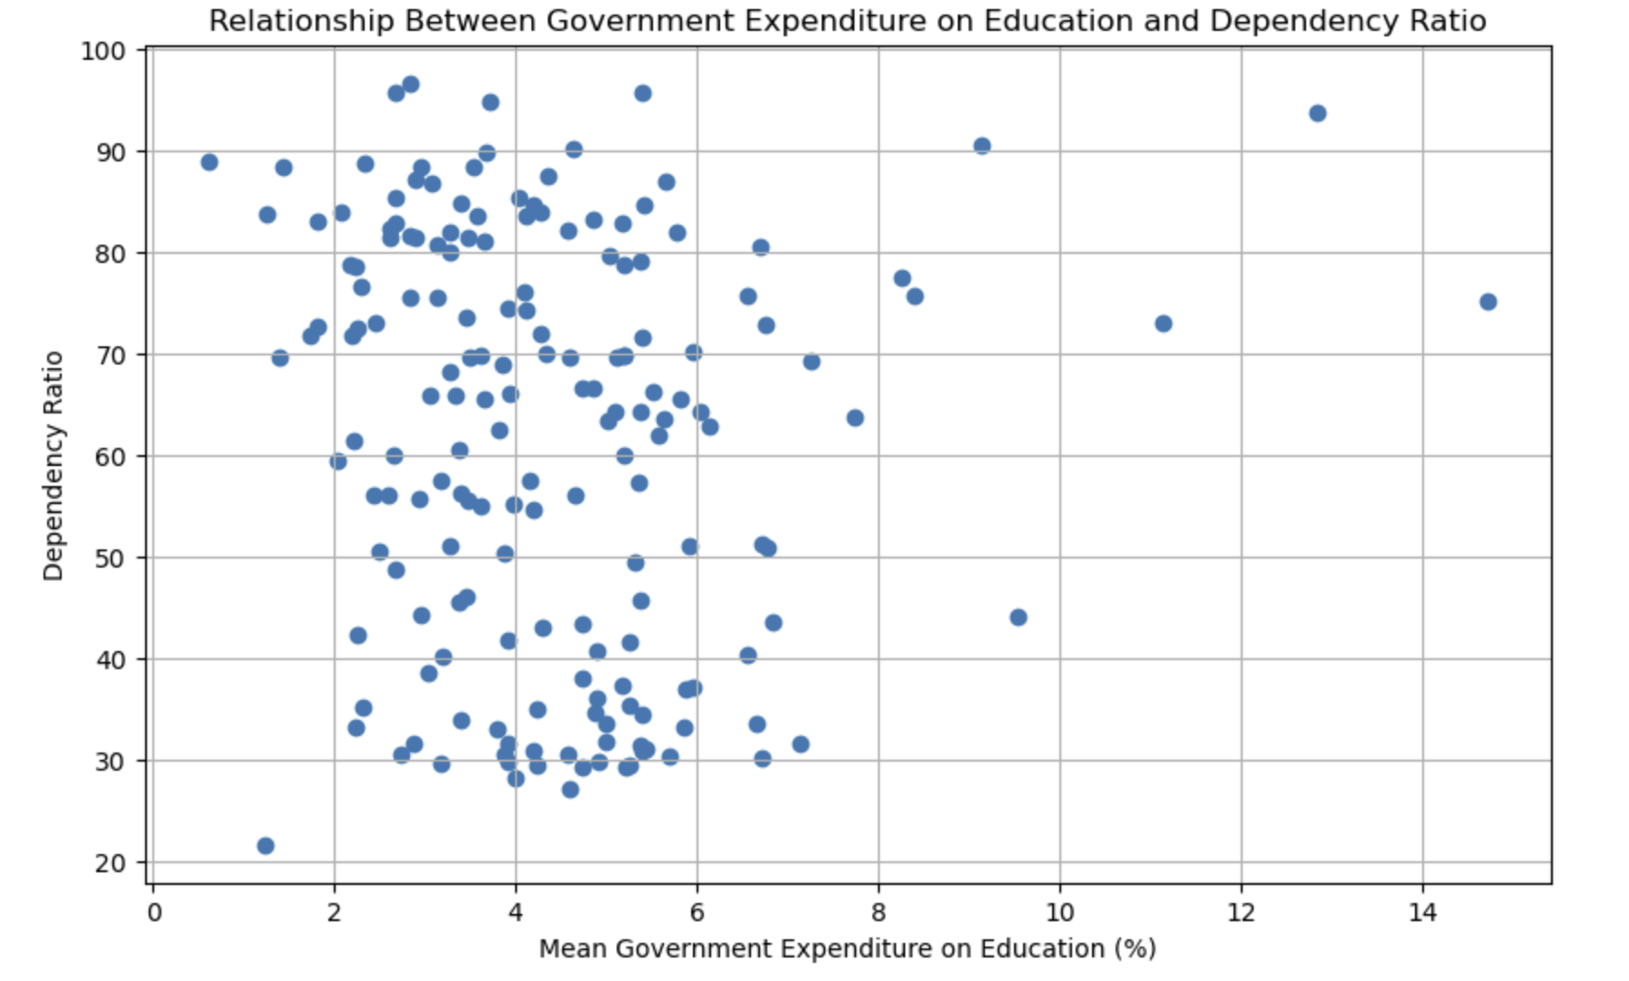
EDA_Demographic_Government.ipnyb
Initial
GDP
Government
Natural Disasters
EDA EXPLANATION (Government)
Correlation = -0.20
Correlation = -0.074
Not much correlation can be seen from the graphs
Correlation might be skewed due to number of missing values (government expenditure) for different countries

Slide 13
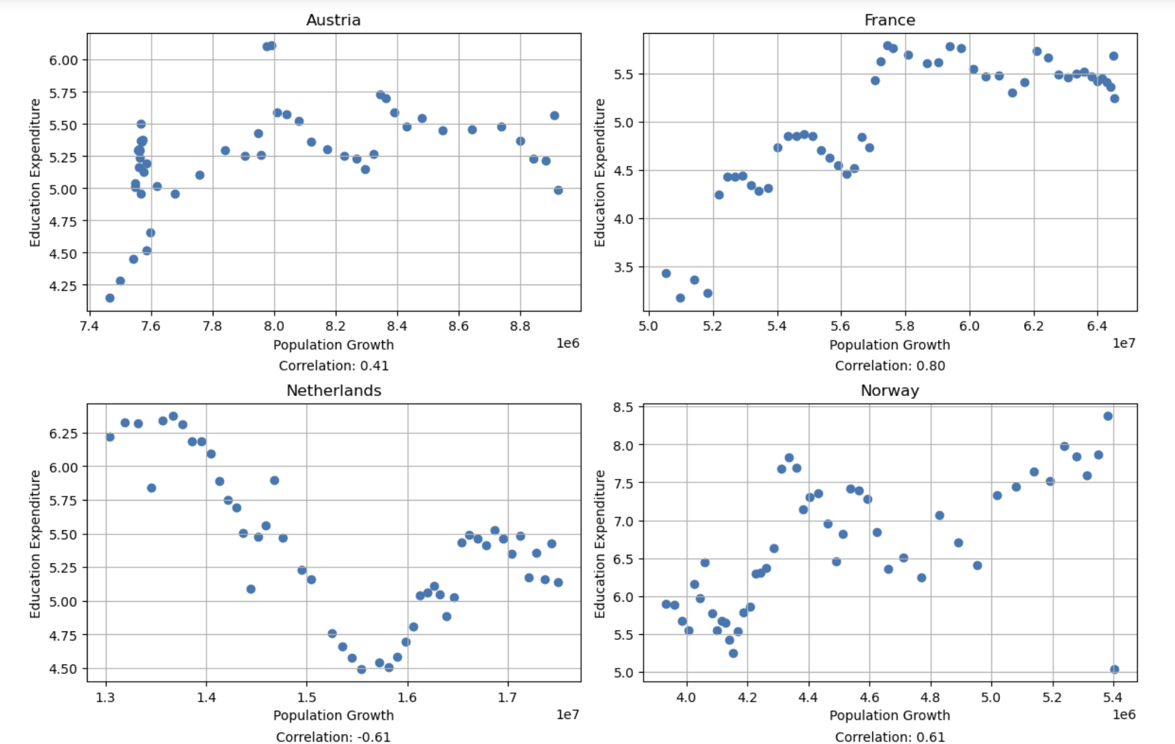
EDA_Demographic_Government.ipynb
Initial
GDP
Government
Natural Disasters
EDA EXPLANATION (Government)
Education expenditure per year in comparison to population growth (per country)
Much better correlation comparing to the mean of all countries

Slide 14
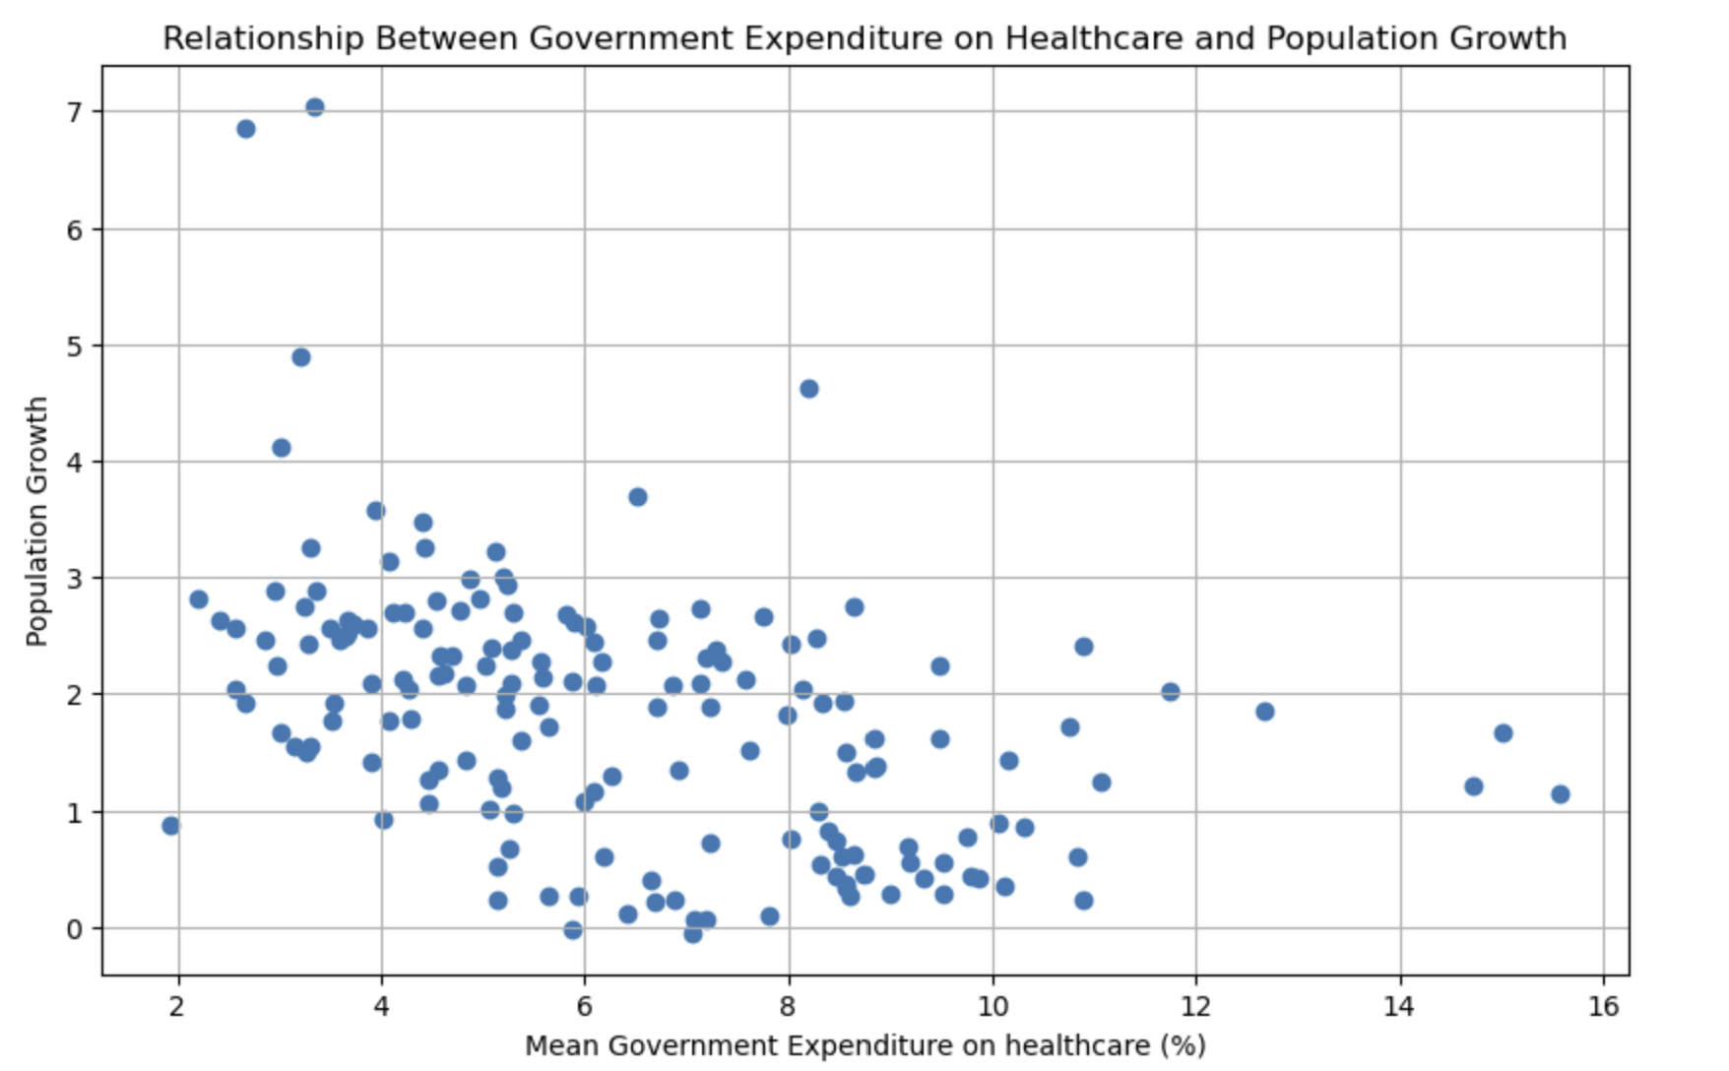
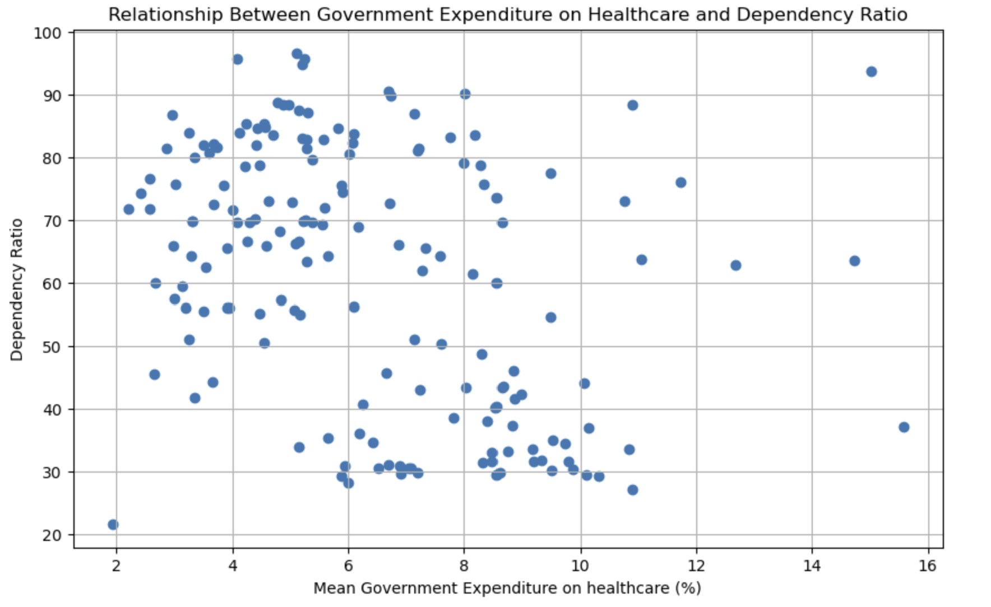
EDA_Demographic_Government.ipynb
Initial
GDP
Government
Natural Disasters
EDA EXPLANATION (Government)
Correlation = -0.437
Correlation = -0.35
Possible indicator for Population Growth given its relation with healthcare expenditure

Slide 15
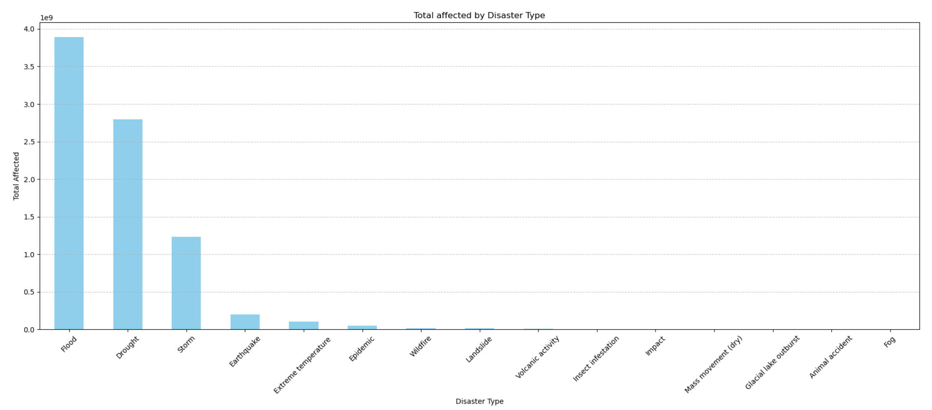
EDA_Demographic_Disaster.ipnyb
Initial
GDP
Government
Natural Disasters
EDA EXPLANATION (Natural Disasters)
Countries with most disasters
1. United States of America (the)
2. China
3. India
4. Philippines (the)
5. Indonesia

Slide 16
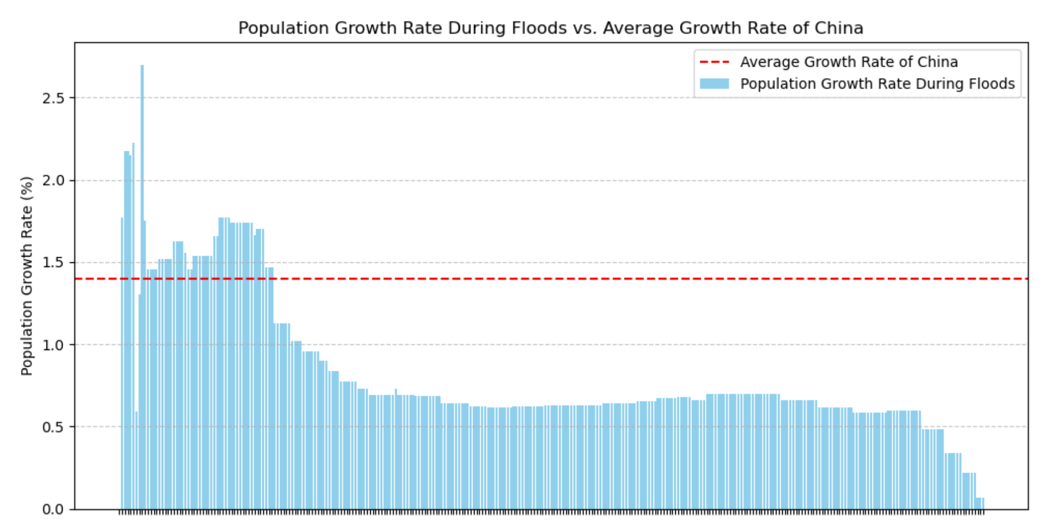
EDA_Demographic_Disaster.ipnyb
Initial
GDP
Government
Natural Disasters
EDA EXPLANATION (Natural Disasters)
Population Growth Rate (%)
Floods

Slide 17
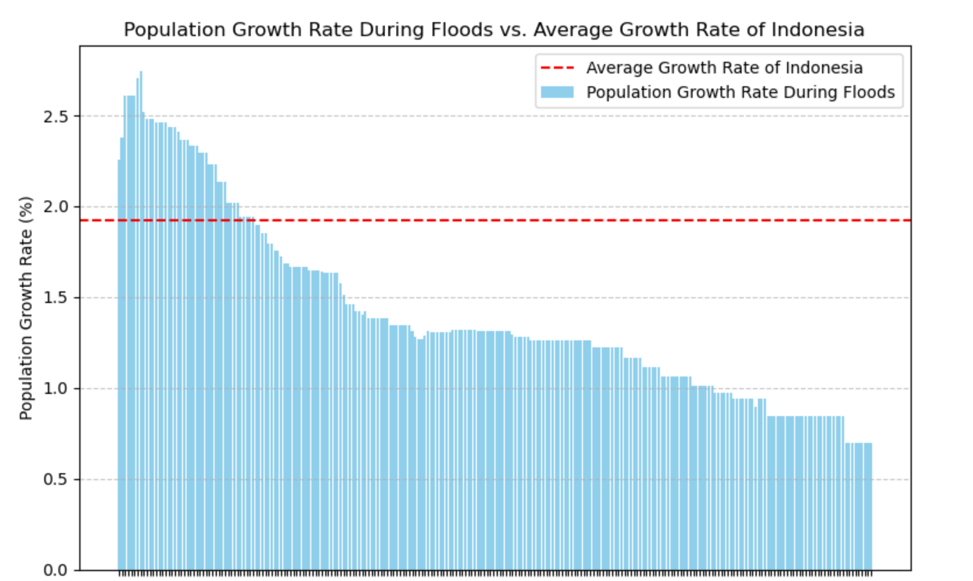
EDA_Demographic_Disaster.ipnyb
Initial
GDP
Government
Natural Disasters
EDA EXPLANATION (Natural Disasters)
Population Growth Rate (%)
Floods

Slide 18
Machine-Learning Models
Analysing Total Dependency Ratio, Child Dependency Ratio and Elderly Dependency Ratio for demographic shifts.
Features that we choose: 'Population', 'GDP', 'GDP Per Capita', 'Population Growth Rate_y', 'GDP Growth Rate', 'Percent_expenditure_education', 'healthcare_expenditure'
Identify key indicators that could potentially cause the change
Using R^2, RMSE and MAE to check the accuracy of the model. Make use of residual graph for further analysis
For simplicity of the presentation, we will look into our analysis for Child dependency ratio for all 3 machine-learning models.
ARIMA model for demographic prediction (not used in final evaluation), more can be seen in initial EDA for this implementation of model

Slide 19
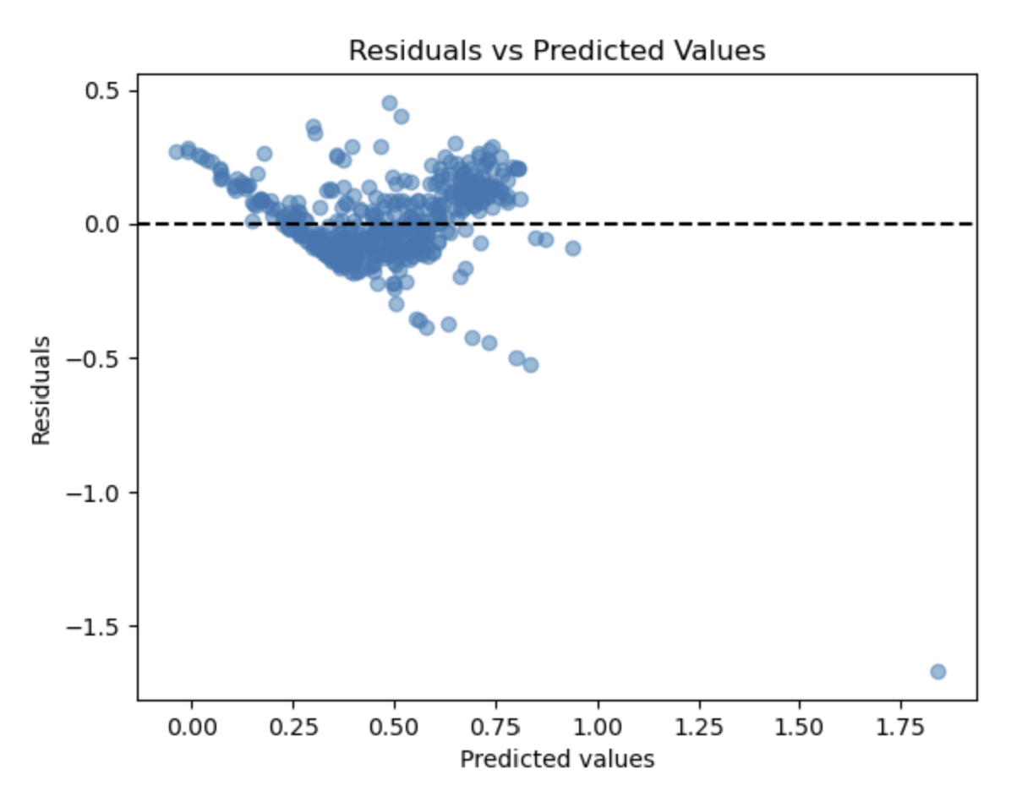
Machine-learning model 1 - Linear Regression (Linreg)
ML_Techniques.ipnyb
Simple linear relationship between features and the target variable
It was able to attain a reasonable R^2 score of 0.56 and MAE, RMSE of 0.11, 0.16 respectively
We feel that the R^2 score can be improved. Moreover, the residual vs predicted graph seems to have a pattern, which can be due to some other underlying relationships.
Hence, we decided to make use of some other models.

Slide 20
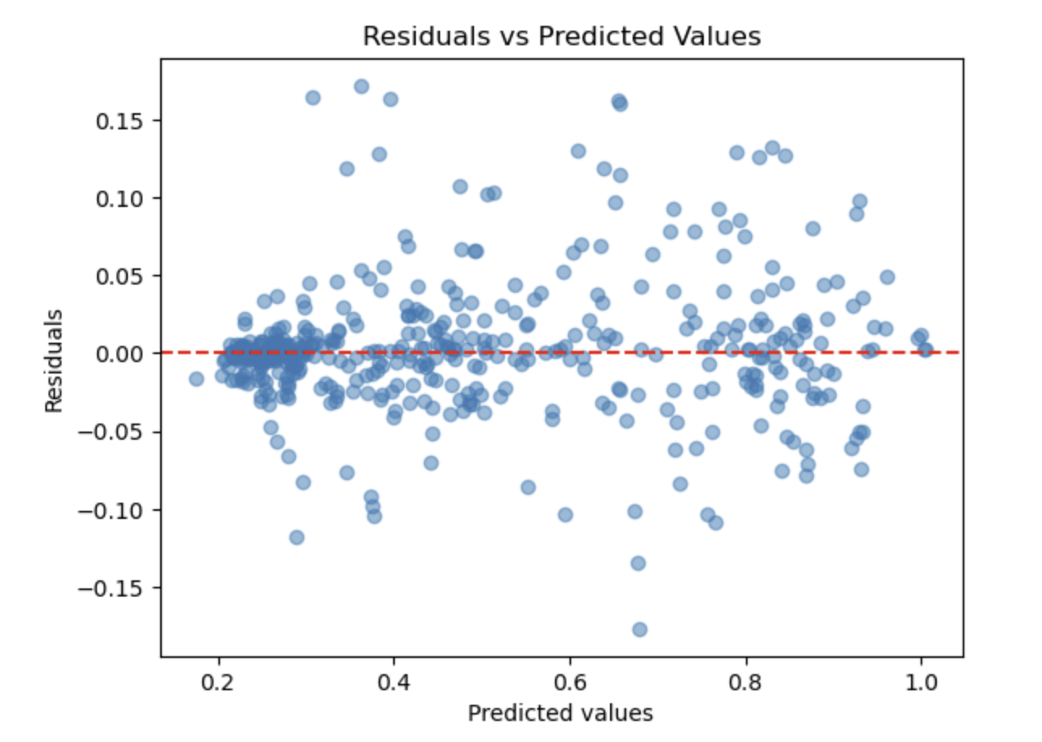
Machine-learning model 2 - Random Forest Regression (RFR)
ML_Techniques.ipnyb
Able to capture non-linear relationships and interactions between features due to ensemble of decision trees, which helps to give a better results.
Using the Random Forest (.feature_importances_), we were able to rank the best features for prediction. This can provide us insights on which indicator would potentially affect different demographics.
The Random Forest Regression model was then implemented, with the chosen features, to predict the Child Dependency Ratio.
The R^2 score attained 0.97 while MAE, RMSE attained 0.027 and 0.043 respectively. Moreover, the residual graph is more random compared to Linreg.

Slide 21
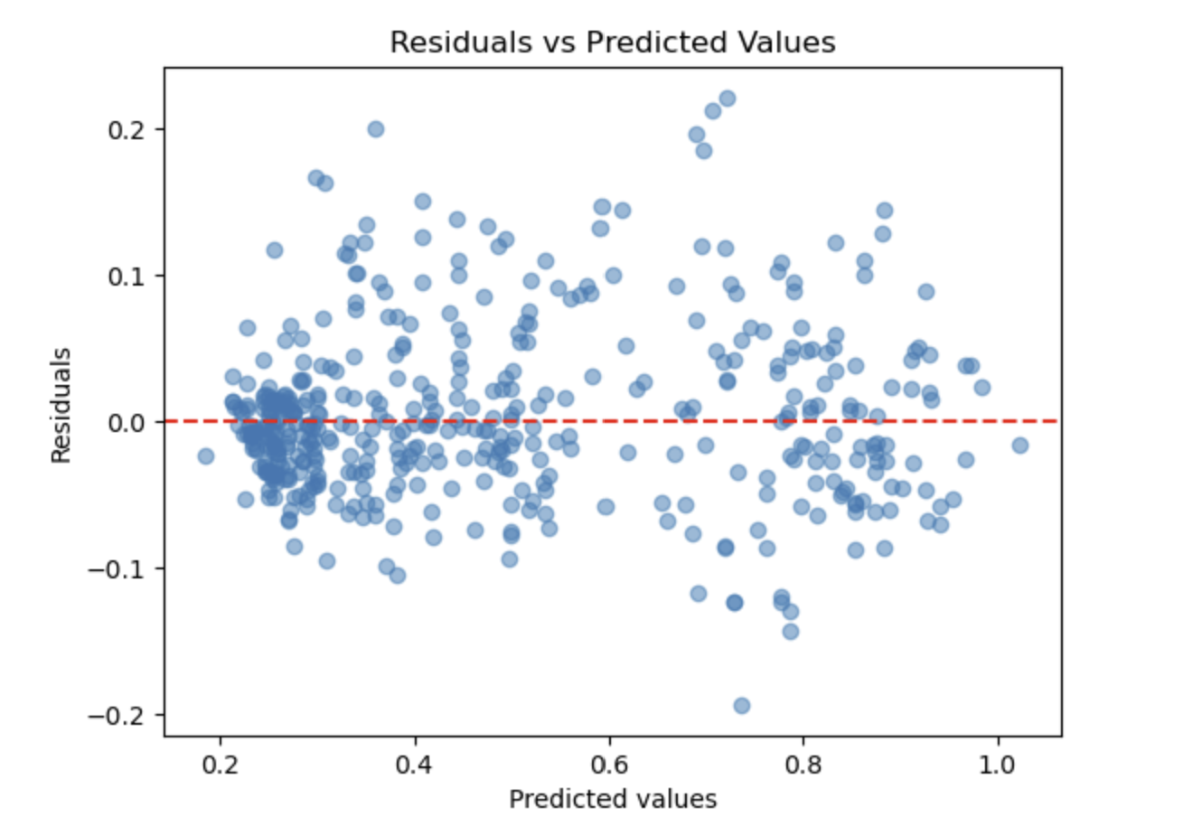
Machine-learning model 3 – Gradient Boosting Machine (GBM)
ML_Techniques.ipynb
Comparable to the other 2 models, GBM has a higher predictive accuracy but is also less robust to outliers, comparing to Random Forest.
Similar to RFR, it has a high R^2 score of 0.97 while MAE and RMSE is slightly higher at 0.043 and 0.056 respectively. The residual graph is also more randomize, in comparison to Linreg.

Slide 22
Conclusion
By Predicting
Through the ml techniques we were able to predict the child dependency, elderly dependency ratios and total dependency ratios
Helps in Adapting
To a Better Future
Leading to more resilient and sustainable communities
Enabling policy makers to adapt new strategies beforehand through the forecasted data

Slide 23
Thank You!

